Slide 1
ISO/TC211/AG 5
Harmonized model maintenance group (HMMG)
56th Plenary Meeting Week Hybrid, Jenonju & Zoom – May 17th 2023 UTC 04:30-05:30
Knut Jetlund, Convenor

Slide 2
ISO Code of Ethics and Conduct

Slide 3

What and why?
The ISO Code of Ethics and Conduct was adopted by the ISO Council in February 2023, replacing the earliy Code of Conduct.
It set out principles for the conduct of persons acting on or behalf of ISO, including the ISO standards development community - us.
The goal is that our deliverables benefit the international community over and above the interests of any individual or
organization.
ISO Code of Ethics and Conduct

Slide 4

All ISO actors must uphold and respect the Code of Conduct
ISO Central Secretariat (ISO/CS)
National standards bodies (NSBs)
Individuals representing those member bodies
ISO committee chairs, committee managers, working group (or any established consensus group under a committee) convenors, WG secretaries, project leaders
Delegates and experts, including liaisons

Slide 5
Principles
Comply with legal and statutory obligations
Perform and act in good faith, consistent with the purpose, policies and principles of the organization
Behave ethically
Promote and enable all voices to be heard
Engage constructively in ISO activities
Declare actual and potential conflicts of interest and manage them appropriately
Protect confidential information
Protect ISO assets
Avoid and prevent any form of bribery or corruption
Escalate and resolve disputes and uphold agreed resolution
Notes:
Same as before: 3
Slightly extended: 10
Reworded: 5
The others were all in the directives?

Slide 6
Agenda
 | Agenda item | Chair
1 | Welcome and introduction | HMMG Convenor
2 | Roll call | All
3 | Status for the Harmonized Model and the Programme of work (https://committee.iso.org/sites/tc211/home/projects/projects---graphic-overview.html) | HMMG Convenor
4 | Project Teams’ work with the Harmonized Model | HMMG Convenor
5 | HMMG work and model maintenance | HMMG Convenor
6 | Issues from project meetings | All
7 | HMMG Recommendations and report to the plenary | HMMG Convenor
8 | Any other business | All
9 | Close | All

Slide 7

Status for the HM and POW
UML models shall be in the HM before CD/DTS ballot
UML models shall be controlled between the CD and DIS stages
Documents shall not pass ballot until the review is completed
Because…
Derivation of resources for implementation - XSD, OWL
Reuse in other standards and by other stakeholders
Reuse in future revisions
Automated documentation

Slide 8
Status for the HM and POW
The cooperation with PTs and WGs is very good at the moment.
Projects are working in different ways
Depending on technical restrictions and possibilities set by governments and employers.
More interactive work:
Virtual PT and WG Meetings, GitHub and ISO Documents, Email discussions, Cloud sharing…
Easier to follow and controll the UML work
HMMG members can attend more PT and WG meetings.
Can participate in discussions on GitHub

Slide 9
Accessing and working with the HM
https://github.com/ISO-TC211/HMMG/wiki#accessing-the-isotc-211-harmonized-uml-model
HM cloud repository (read/write access, for editors)
Cloud based, latest versions of all approved changes for all models
Sparx ProCloud Web (open for anyone)
http://iso.sparxcloud.com/index.php
Sparx ProCloud Reusable Asset Service (RAS)
Read access - download published versions of individual model packages directly into any EA project
GitHub resources:
Standalone ‘Official’ EA project – periodically synchronized with ProCloud
Standalone ‘Editorial’ EA project – periodically synchronized with ‘Official’ EA project + ‘Editorial’ Packages
ProCloud is the primary repository
EA projects on GitHub are provided for convenience, and are used by several PTs

Slide 10


Tools for UML modelling
EA is mandatory for all UML work!
Use a recent version (EA 15 or 16)
…
EA version 16 64 bit released last year https://sparxsystems.com/products/ea/16.0/index.html
Good: New file format .qea – based on SQLite
Challenge: Cannot read .eap
Can read .eapx if 64 bit Jet DB Driver
.eap and .eapx can be upgraded to .qea with wizard
GitHub resources will be both .eap and .qea until further notice

Slide 11
Enterprise Architect Licenses
Sparx Systems provides free licenses for development and maintenance of the Harmonised Model
Experts, Project leaders, Editors, Convenors…
Requests are handled through the ISO/TC 211 Secretariat

Slide 12

TODO: Model maintenance
Done and maintained:
RAS for individual packages
Cleaning:
Clean up errorenous dependencies
Clean up profiles and stereotype references
Add missing definitions
Extended quality control and maintenance
Update HMMG and UML Best Practices Wikis

Slide 13
Other issues
Collaboration with OGC
OGC is setting up a ProCloud with a Harmonized OGC UML Model
Potential for good integration of models
Potential for exchanging experiences
Sparx follow-up
Joint meeting with OGC and Sparx on ProCloud issues
Specified several other issues that should bee discussed
Formalization of collaboration

Slide 14
TODO: Formalization of the collaboration with Sparx Systems
(Still) preparing for a formalized collaboration in order to:
Improved communication and support
Support for UN 2030 Sustainable Development Goals through UN-GGIM
Increased participation to support the growth of geospatial standards in other geographical areas.
Especially Africa and Latin-America
Licenses to universities, colleges and study centers worldwide
Special focus on developing countries
Shared focus on collaboration between standardization communities
ITS, BIM, Smart Cities, etc.
ISO/TC 211, OGC, IHO, buildingSMART etc.

Slide 15
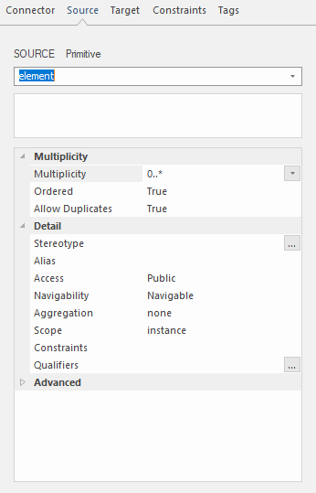
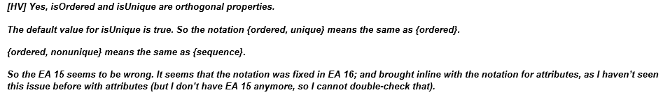
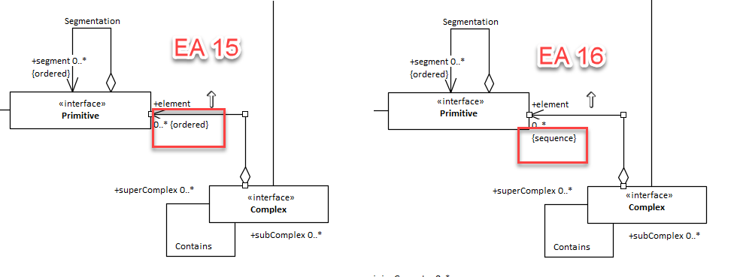
Other issues – {ordered} vs {sequence}

Slide 16
Other issues from projects
ISO 19111 19111 minor errors · Issue #475 · ISO-TC211/StandardsTracker (github.com)
Access control in ProCloud seems to have holes. Users with editing privileges for one package may also edit other locked packages

Slide 17
Suggested resolutions
Need for a new resolution covering controls by management groups “before the time that the document is submitted to stage…”
30, 40, 50, 60
“…shall not pass the ballot…”
To replace and strengthen resolutions 891 and 987

Slide 18
HMMG Meeting Highlights
Status
Almost all project models in or on the way into the HM
Good cooperation with most PTs
HM Improvements
Several improvements of the HM in progress
We need technical experts from member states to contribute to the work
Cooperation with OGC and Sparx
Integration of models
Exchange of experiences
Follow up with Sparx on some suggested improvements
HMMG Attendance
Project leaders, editors and WG convenors must register as HMMG Members and are expected to attend the HMMG meeting

Slide 19
HMMG Meeting Highlights
EA is mandatory for all UML work!
Use a recent version (15 or 16)
Sparx Systems provides free licenses for development and maintenance of the Harmonised Model
Experts, Project leaders, Editors, Convenors…
Requests are handled through the ISO/TC 211 Secretariat

Slide 20
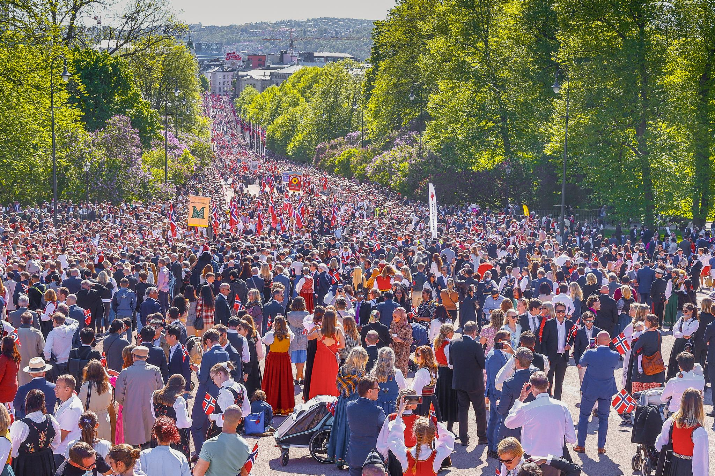
Any other business?

